Slide 1
Array
Java array is an object which contains fixed set of elements of a similar data type.
Array contains primitives data types as well as objects of a class depending on the definition of array.
Index-based, the first element of the array is stored at the 0th
index, 2nd element is stored on 1st index and so on.

Slide 2
Types
One dimensional array
Multi dimensional array

Slide 3
One dimensional array
one-dimensional array is particularly a list of like-typed variables.
To create an array, you first must create an array variable of the desired type.
The general form of a one-dimensional array declaration is
type var-name[ ];
Example: int month_days[ ];

Slide 4
//array variable declaration
type var-name[ ]; int month_days [ ];
//instantiation allocation of array var = new datatype[size];
month_days = new int[12];
We Can Combine Array Variable Declaration and allocation of Array, as shown here
int month_days[] = new int[12];

Slide 5
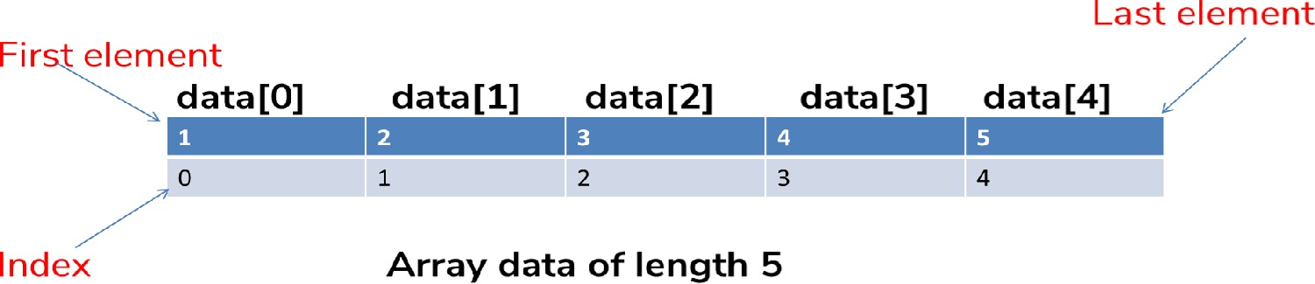
Java array index
int data[]=new int[5];

Slide 6
Initializing Array Values – Type 1
class Array {
public static void main(String args[]) {
int month_days[]; month_days = new int[12];
month_days[0] = 31;
month_days[1] = 28;
month_days[2] = 31;
month_days[3] = 30;
month_days[4] = 31;
month_days[5] = 30;
month_days[6] = 31;
month_days[7] = 31;
month_days[8] = 30;
month_days[9] = 31;
month_days[10] = 30;
month_days[11] = 31;
Syntax
Var_name[index] = value
System.out.println("April has " + month_days[3] + " days.");
}
}

Slide 7
Initializing Array Values – Type 2
// An improved version of the previous program. class AutoArray {
public static void main(String args[]) {
int month_days[] = { 31, 28, 31, 30, 31, 30, 31, 31, 30, 31,
30, 31 };
System.out.println("April has " + month_days[3] + " days.");
}
}

Slide 8
1
2
3
4
5
6
7
8
9
1
0
1
1
1
2
class Testarray1{
public static void main(String args[]){
int a[]={33,3,4,5};
for(int i=0;i<a.length;i++) System.out.println(a[i]);
}
}
1
Output
3
1
4
1
5
33
3
4
5

Slide 9
1
2
3
4
5
6
7
8
9
1
0
1
1
1
2
class Testarray2{
public static void main(String args[]){
int arr[]={33,3,4,5};
for(int i:arr)
System.out.println(i);
}
}
1
Output
3
1
4
1
5
33
3
4
5

Slide 10
Syntax
Forms
ElementType [] arrayName;
ElementType [] arrayName =
new ElementType [size];
ElementType [] arrayName =
array-literal;
Where:
  ElementType is any type
  arrayName is the handle for the array
  array-literal is a list of literals enclosed in curly braces { }

Slide 11
Array Length
Refer to array length using length
A data member of array object array_variable_name.length
Sample Code:
long[] primes = new long[20]; System.out.println(primes.length); Output: 20

Slide 12
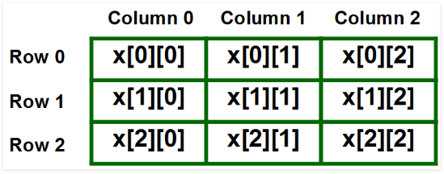
Multi dimensional array
Elements in two-dimensional arrays are commonly referred by x[i][j] where ‘i’ is the row number and ‘j’ is the column number.

Slide 13
Multi dimensional array
//Variable declaration
datatype var[][];
int twoD[][];
//instantiation allocation of array
var = new datatype[rowsize][columnsize];
twoD= new int[4][5]
Combination of Array Variable Declaration and Allocation of Array
int twoD[][] = new int[4][5];

Slide 14
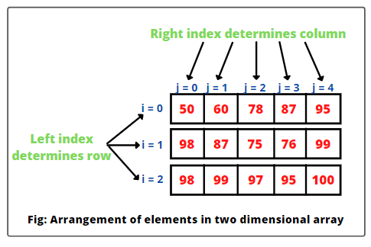
2d array Using Loop

Slide 15
// Demonstrate a two-dimensional array. class TwoDArray {
public static void main(String args[]) { int twoD[][]= new int[4][5];
int i, j, k = 0; for(i=0; i<4; i++)
for(j=0; j<5; j++) {
twoD[i][j] = k; k++;
}
for(i=0; i<4; i++) {
for(j=0; j<5; j++) System.out.print(twoD[i][j] + " "); System.out.println();
}
}
}

Slide 16
class MultidimensionalArray {
public static void main(String[] args) {
// create a 2d array int[][] a = {
{1, 2, 3},
{4, 5, 6, 9},
{7},
};
// calculate the length of each row System.out.println("Length of row 1: " + a[0].length); System.out.println("Length of row 2: " + a[1].length); System.out.println("Length of row 3: " + a[2].length);
}
}

Slide 17
1
2
3
4
5
6
7
8
9
1
0
1
1
1
2
class Testarray3{
public static void main(String args[]){
int arr[][]={{1,2,3},{2,4,5},{4,4,5}};
for(int i=0;i<3;i++){ for(int j=0;j<3;j++){
System.out.print(arr[i][j]+" ");
}
System.out.println();
}
}
}
1
Output
3
1
4
1
5
1 2 3
2 4 5
4 4 5

Slide 18
1
2
3
4
5
6
7
8
9
1
0
1
1
1
2
class Testarray4{
public static void main(String args[]){
int arr[][]={{1,2,3},{4,5,6},{4,4,5}};
for(int x[]:arr)
{
for(int y:x)
{
System.out.print(y+" ");
}
System.out.println();
}
}
}
1
Output
3
1
4
1
5
1 2 3
2 4 5
4 4 5

Slide 19
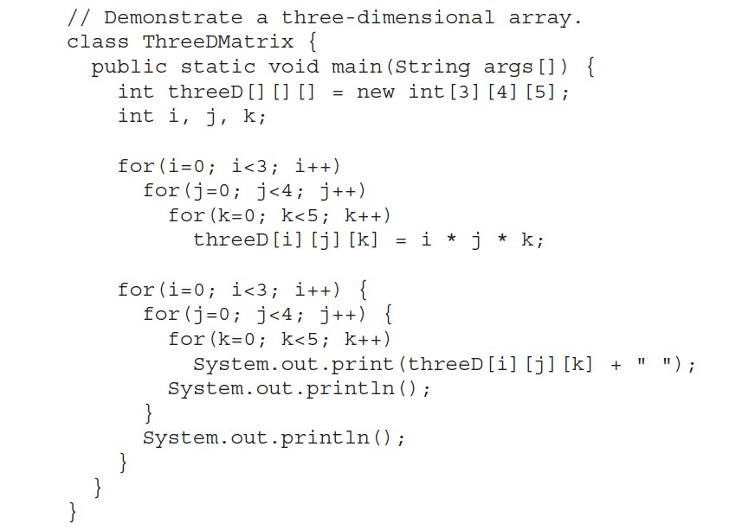
Three Dimensional Array
19

Slide 20
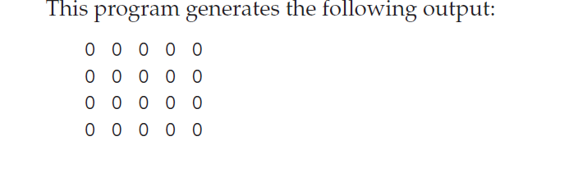
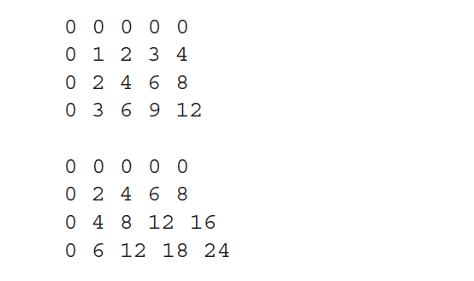
Output
20

Slide 21
Java String
Generally, String is a sequence of characters.
But in Java, string is an object that represents a sequence of characters.
The java.lang.String class is used to create a string object.
There are two ways to create String object
By new keyword
By without new keyword (String Literal)
■
■
21

Slide 22
Create a variable of type String and assign it a value:
public class StringExample{
public static void main(String args[]){
String s1="java"; //creating string by Java string literal
char ch[]={'s','t','r','i','n','g','s'};
String s2=new String(ch); //converting char array to string
String s3=new String("example");//creating Java string by new keyword
System.out.println(s1); System.out.println(s2);
System.out.println(s3);
}}
22

Slide 23

String Literal - String str = “Hello”
How it is working in the backend?
str
Hello
String objects are stored in a special memory area known as the "string constant pool".
String pool
Heap

Slide 24


String Literal - String str = “Hello”
How it is working in the backend? String str1 = “Hello”
If we create an object using String literal. It may return an existing object from the String pool, if it already exists.
Otherwise, it will create a new String object and put in the string pool for future re-use.
str
Hello
The same reference will be assigned to str and str1.
str1
Why Java uses the concept of String literal? To make Java more memory efficient (because no new objects are created if it exists already in the string constant pool).
String pool
Heap

Slide 25



new - String s = new String(“Hello”)
How it is working in the backend?
str
Hello
str1
s
String pool
Heap

Slide 26


new - String s = new String(“Hello”)
How it is working in the backend?
In such case, JVM will create a new string object in heap memory, and the literal “Hello" will be placed in the string constant pool. The variable “s” will refer to the object in a heap.
Therefore, if we compare performance of string literal and string object, string object will always take more time to execute than string literal because it will construct a new string every time it is executed.
Note: Execution time is compiler dependent.
str
Hello
str1
s
Hello
String pool
Heap

Slide 27
class StringStorage {
public static void main(String args[])
{
String s1 = "TAT"; String s2 = "TAT";
String s3 = new String("TAT");
String s4 = new String("TAT"); System.out.println(s1); System.out.println(s2); System.out.println(s3); System.out.println(s4);
}
}

Slide 28
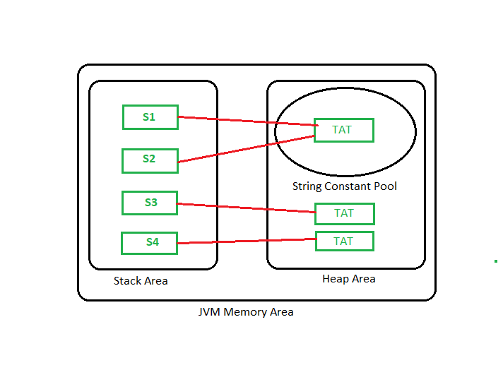

Slide 29
Java String split()
Splits the string at the specified string
(regex)
Java String compareTo()
Compares two strings in the dictionary order
Java String compareToIgnoreCase() Compares two strings ignoring case differences
Java String length()
Returns the length of the string Java String replace()
Replace all matching characters/text in the
string
Java String replaceAll()
Replace all substrings matching the regex pattern
Java String substring()
Returns a substring from the given string
Java String equals()
Compares two strings

Slide 30
Java String trim()
Removes any leading and trailing whitespace
Java String charAt()
Returns the character at the given index
Java String toLowerCase()
Converts characters in the string to lower case
Java String concat()
Concatenates two strings and returns it Java String valueOf()
Returns the string representation of a value Java String matches()
checks whether the string matches the given regex
Java String startsWith()
Checks if the string begins with the given
string
Java String valueOf()
Returns the string representation of a value

Slide 31
Java String matches()
checks whether the string matches the given regex
Java String startsWith()
Checks if the string begins with the given string
Java String equalsIgnoreCase() Compares two strings ignoring case differences
Java String contains()
Checks whether the string contains a substring
Java String indexOf() Returns the index of the character/substring Java String endsWith()
Checks if the string ends with the given string
Java String isEmpty()
Checks whether a string is empty or not

Slide 32
Java String intern()
Returns a canonical representation of the string
Java String getBytes()
Encodes the string into a sequences of bytes
Java String contentEquals()
Checks whether the string is equal to charSequence
Java String hashCode()
Returns a hash code for the string Java String join()
Joins the given strings using the delimiter Java String replaceFirst()
Replace the first matching substring
Java String subSequence()
Returns a subsequence from the string Java String toCharArray()
Converts the string to a char array Java String format()
Returns a formatted string

Slide 33
The charAt() method
The java String charAt() method returns a char value at the given index number
The index number starts from 0 and goes up to (n-1), where n is length of the string.

Slide 34
1
2
3
4
5
6
7
8
9
1
0
1
1
1
2
// Predict the output of the below code
class Main{
public static void main(String args[]){ String str = "Java";
char ch = str.charAt(2); System.out.println(ch); System.out.println(str.charAt(3)); System.out.println(str.charAt(4)); System.out.println(str.charAt(-1));
}
}
1
Output
3
1
4
1
5
v
a
Error

Slide 35
The toUpperCase() method
The java String toUpperCase() method converts all the lowercase characters of a string into uppercase
It will not alter the already existing uppercase characters in the string.
E.g: System.out.print(“You are on the right track”.toUpperCase());
Output: YOU ARE ON THE RIGHT TRACK

Slide 36
The toLowerCase() method
The java String toLowerCase() method converts all the uppercase characters of a string into lowercase
It will not alter the already existing lowercase characters in the string.
E.g: System.out.print(“YOU ARE ON THE RIGHT TRACK”.toLowerCase());
Output: you are on the right track

Slide 37
The concat() method
The Java string concat() method allows you to join two strings. This method returns a string with the value of the string passed into the method is appended to the end of the string.
E.g:
String s1 = "Nice "; String s2 = " Day";
System.out.println(s1.concat(s2));
Output: Nice Day

Slide 38
+ operator
+ operator is also used to concatenate strings
E.g:
System.out.println("You " + "are " + "the " + "best");
Output:
You are the best

Slide 39
// Predict the output
1
2
3
4
5
6
7
8
9
1
0
1
1
1
2
1
3
1
4
class Main{
public static void main(String[] args) { String s = "Are", t = "you", u = "ready"; System.out.println(s + t + u); System.out.println(s.concat(t));
}
}
Output: Areyouready Areyou
Number of arguments the concat() method and + operator takes:
concat() method takes only one argument of string and concatenate it with other string.
+ operator takes any number of arguments and concatenates all the strings.
1
5
1

Slide 40
// Predict the output
1
2
3
4
5
6
7
8
9
1
0
1
1
1
2
1
3
1
4
class Main{
public static void main(String args[]){ String s = 50 + 50 + "error" + 50 + 50; System.out.println(s);
}
}
1
5
1

Slide 41
// Predict the output
1
2
3
4
5
6
7
8
9
1
0
1
1
1
2
1
3
class Main{
public static void main(String args[]){ String s = 50 + 50 + "error" + 50 + 50; System.out.println(s);
}
}
Output:
100error5050
After a string literal, all the + will be treated as string concatenation operator.
1
4
1
5
1

Slide 42
1 // Predict the output
2
class Main{
public static void main(String args[]){
String s = "Apple";
int a = 10;
System.out.println(s + a);
System.out.println(s.concat(a));
9 }
1 }
0
1
1
1
2
1
3
error: incompatible types: int cannot be converted to String System.out.println(s.concat(a));
1
4
1
5
1

Slide 43
// Predict the output
1
2
3
4
5
6
7
8
9
1
0
1
1
1
2
1
3
1
4
1
class Main{
public static void main(String args[]){ String s = "Great", t = ""; String u = s.concat(t);
if(u == s){
System.out.println("Same");
}
else{
System.out.println("Not same");
}
String e = s + t;
if (e == s){
System.out.println("Same");
}
else{
System.out.println("Not same");
}
}
5
1
}

Slide 44
Output: Same Not same
concat() method takes concatenates two strings and return new string object only string length is greater than 0, otherwise it returns same object.
+ operator creates a new string object every time irrespective of length of string.
45

Slide 45
// Predict the output
1
2
3
4
5
6
7
8
9
1
0
1
1
1
2
1
3
1
4
1
5
1
class Main{
public static void main(String args[]){ String s = "Great", t = "H"; String u = s.concat(t);
if(u == s){
System.out.println("Same");
}
else{
System.out.println("Not same");
}
String e = s + t;
if (e == s){
System.out.println("Same");
}
else{
System.out.println("Not same");
}
}
}

Slide 46
Output: Not Same Not same
46

Slide 47
StringBuffer class
Mutable String: A String that can be modified or changed is known as mutable String. StringBuffer and StringBuilder classes are used for creating mutable strings.
Constructor | Description
StringBuffer() | It creates an empty String buffer with the initial capacity of 16.
StringBuffer(String str) | It creates a String buffer with the specified string..
StringBuffer(int capacity) | It creates an empty String buffer with the specified capacity as length.
47

Slide 48
StringBufferExample.java
class StringBufferExample{
public static void main(String args[]){ StringBuffer sb=new StringBuffer("Hello ");
sb.append("Java");//now original string is changed System.out.println(sb);//prints Hello Java
}
}
Output:
Hello Java
48

Slide 49
StringBufferExample2.java
class StringBufferExample2{
public static void main(String args[]){
StringBuffer sb=new StringBuffer("Hello "); sb.insert(1,"Java");//now original string is changed System.out.println(sb);//prints HJavaello
}
}
Output:
HJavaello
49

Slide 50
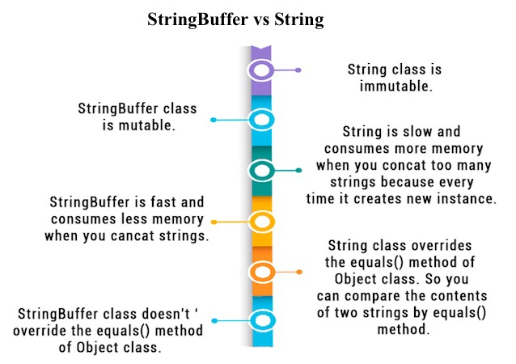
50

Slide 51
 | Methods | Action Performed
 | append() | Used to add text at the end of the existing text.
 | length() | The length of a StringBuffer can be found by the length( ) method
 | capacity() | the total allocated capacity can be found by the capacity( ) method
 | charAt()
 | delete() | Deletes a sequence of characters from the invoking object
 | deleteCharAt() | Deletes the character at the index specified by loc
 | ensureCapacity() | Ensures capacity is at least equals to the given minimum.
 | insert() | Inserts text at the specified index position
 | length() | Returns length of the string
 | reverse() | Reverse the characters within a StringBuffer object
 | replace() | Replace one set of characters with another set inside a StringBuffer object
51

Slide 52
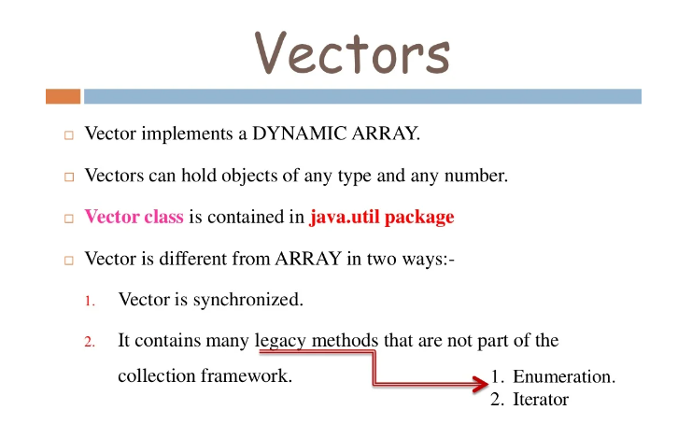
VECTORS

Slide 53
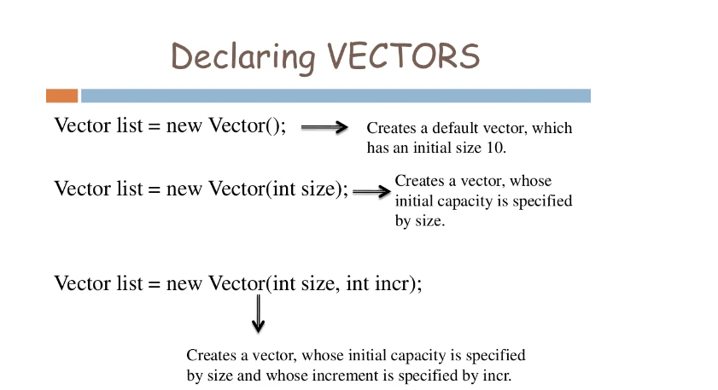

Slide 54
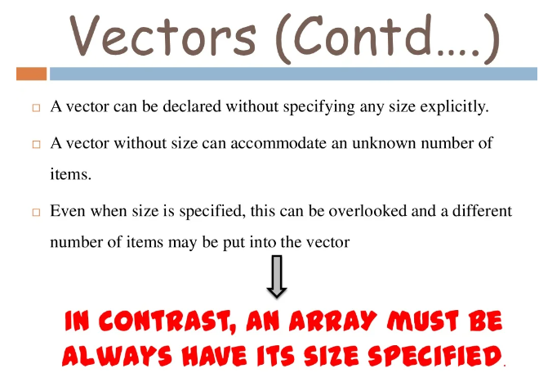

Slide 55
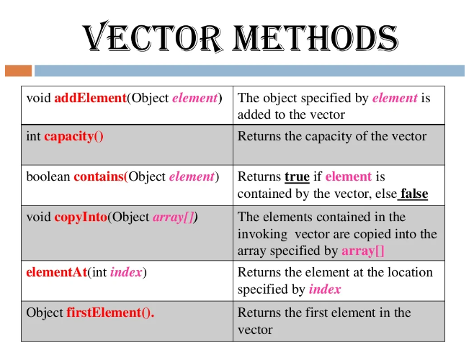

Slide 56
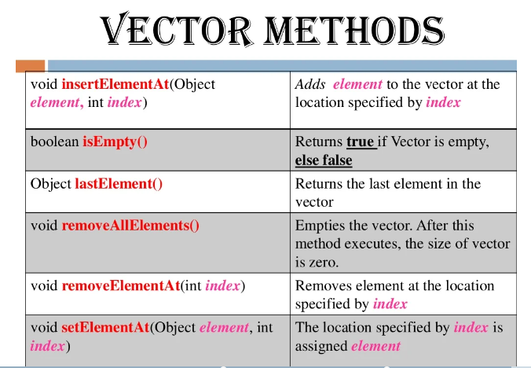

Slide 57
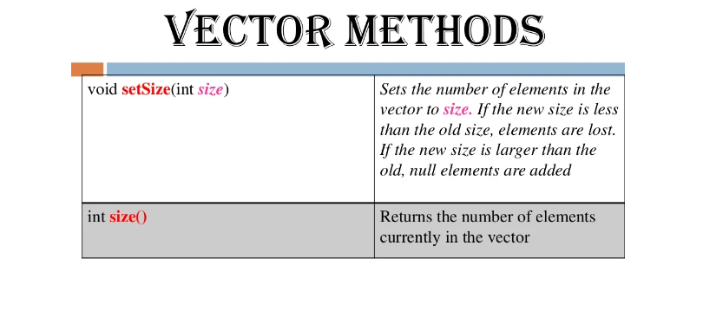

Slide 58
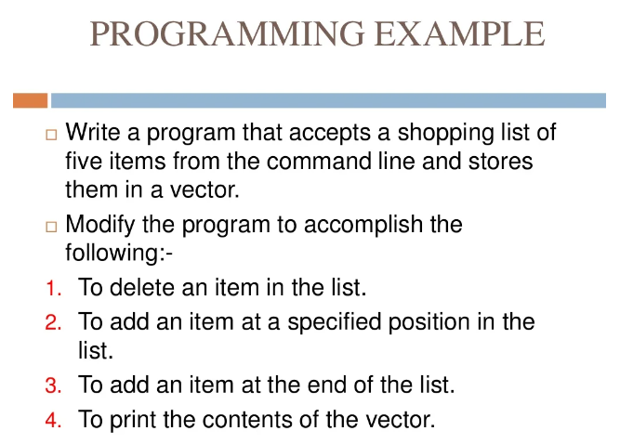

Slide 59
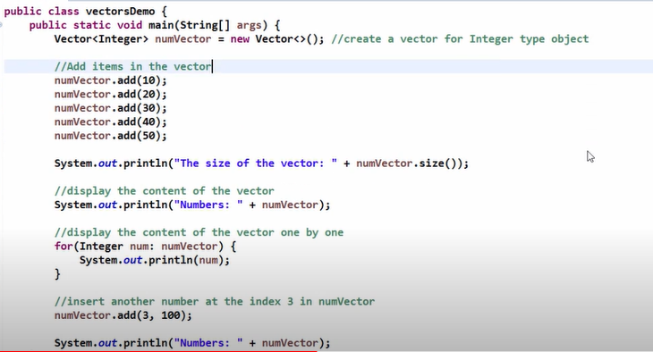

Slide 60
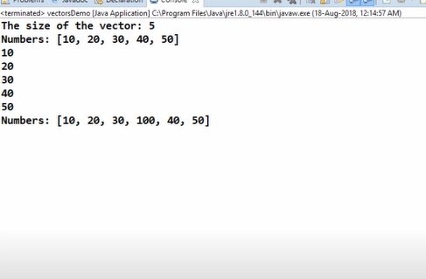

Slide 61
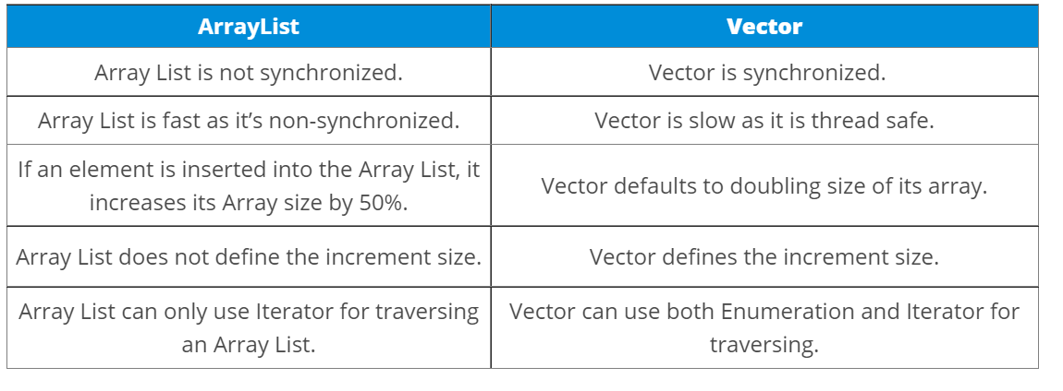

Slide 62
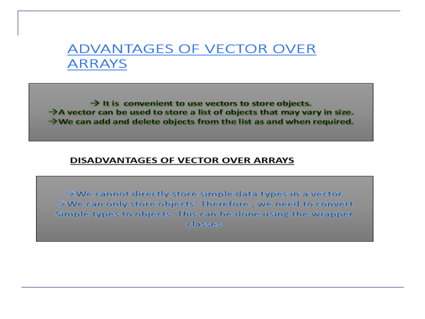

Slide 63
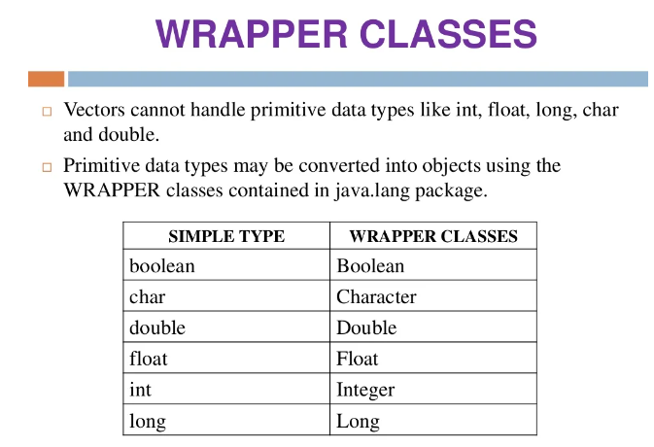

Slide 64
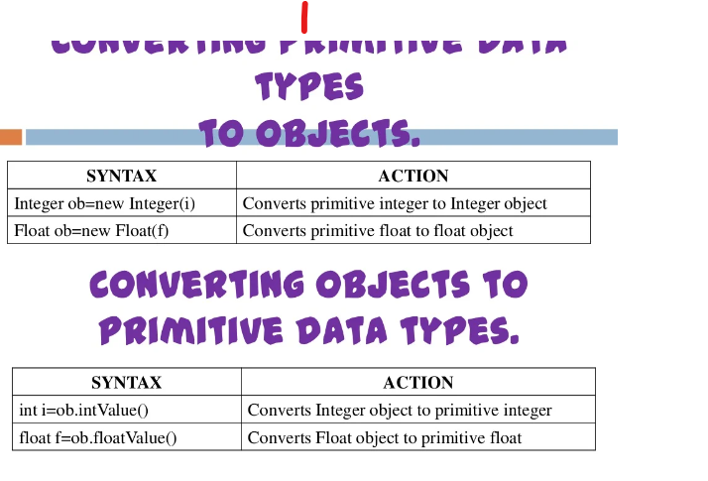
Converting primitive

Slide 65
